Slide 1
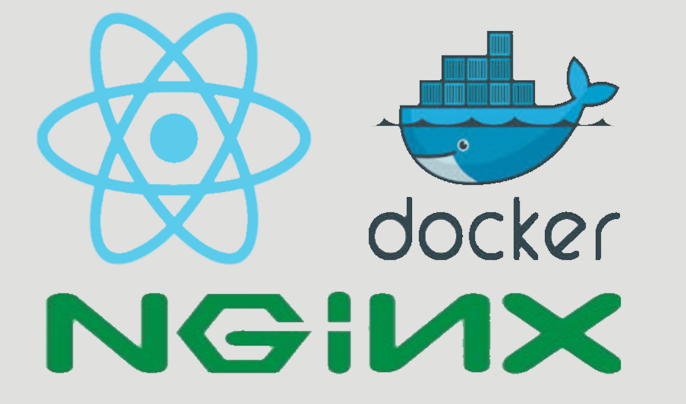
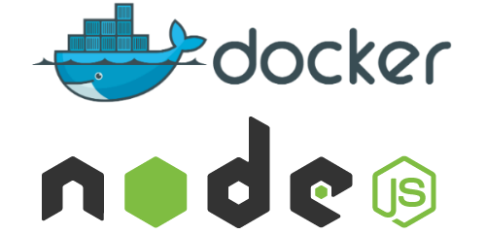
Deploy NodeJs & React On Docker
By Gautam Kumar(Soe Win)
G-Tech

Slide 2
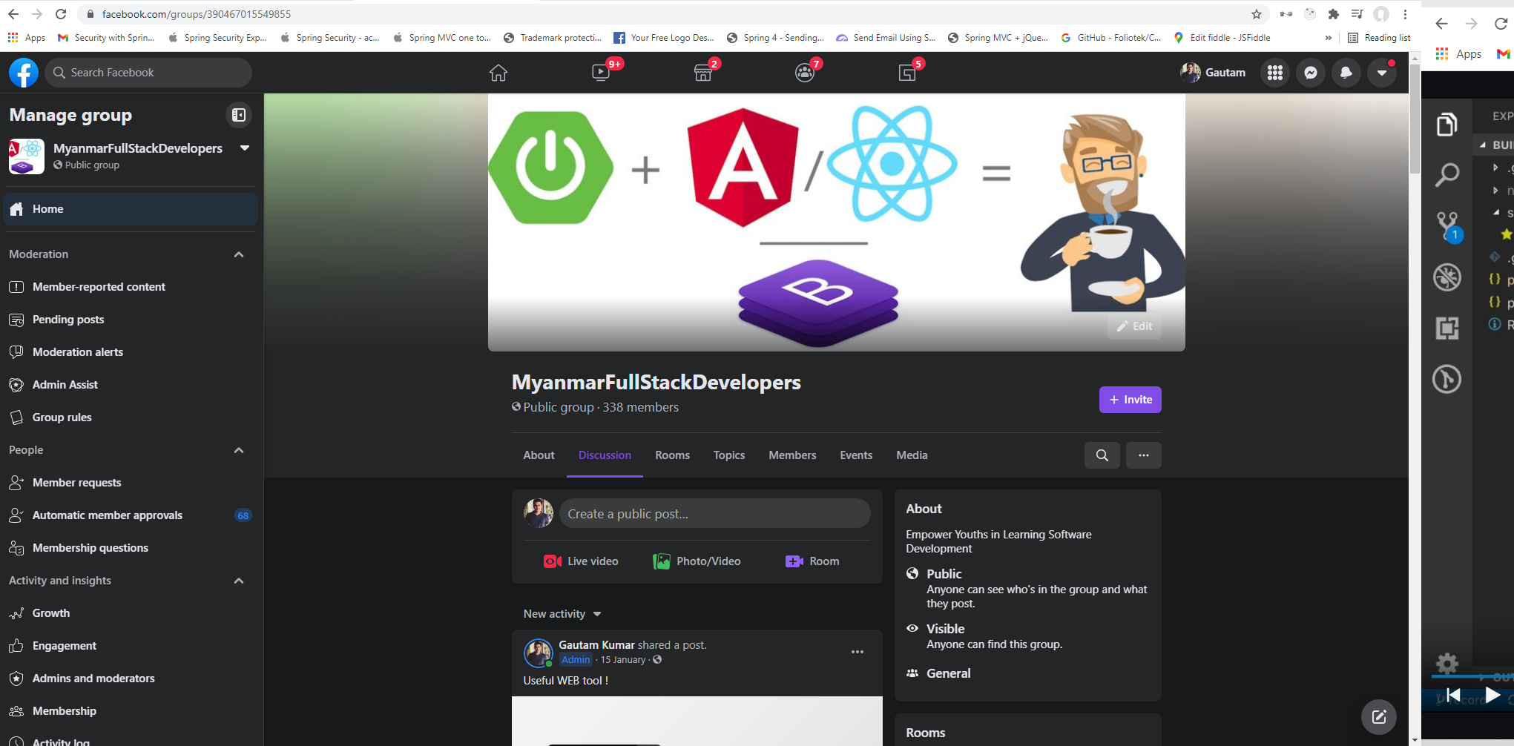
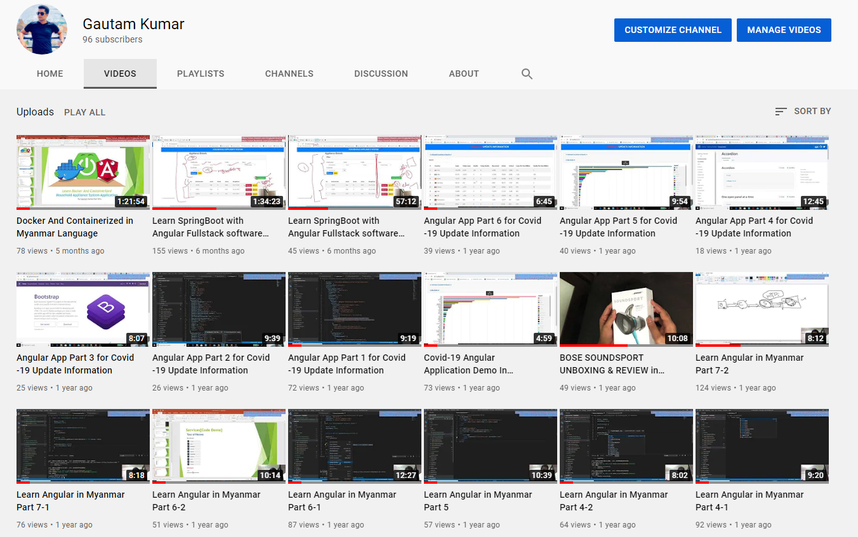

Slide 3

Can you deploy NodeJS on Docker ?
Can you deploy ReactApp on Docker ?

Slide 4
Contents
What we have done so far for React Project…
What is our plan ?
A brief About Docker
React on Docker Setup
Build & Run Docker Image
What is JSON Server
Quick Intro on NodeJs and Why it is needed
NodeJs on Docker Setup
Build & Run Docker Image
Test
Conclusion

Slide 5


What we have done so far for React Project…
Confuse :/
React Component Approaches
Initial App Structure
Redux Intro
Actions, Store and Reduce
Connecting React to Redux
Redux Flow
Async Writes in Redux
Async Status & Error Handling
Testing React
Testing Redux
Production Build
Conclusion
Lets Re-Cap

Slide 6
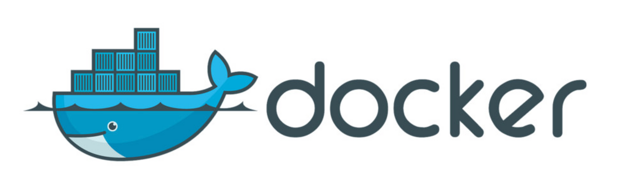
What is Our Plan ?
ReactRedux(FE) ---------------- JsonServer(BE)
ReactRedux FE
JsonServer BE
Dockerfile
Dockerfile

Slide 7



A brief About Docker
https://www.youtube.com/watch?v=0j_sBWMxaLY&list=PL2j5ITxSQFGQX1CKU2rhpV4SN40R7GnF3
https://github.com/soewin90/houseappliance-spring-backend.git
https://github.com/soewin90/houseappliance-angular-frontend.git
https://www.facebook.com/groups/390467015549855
https://www.facebook.com/groups/390467015549855

Slide 8

React on Docker Setup
We will work on more practical
Build & Run Docker Image

Slide 9
What is JSON Server
You can setup a full backend server, e.g. by using Node.js, Express and MongoDB. However this takes some time and a much simpler approach can help to speed up front-end development time
JSON Server is quick and easy to create demo REST JSON services
Provide routes which are pathways through which the requests are processed in a pipeline

Slide 10
Quick Intro on NodeJs and Why it is needed
Open source, cross-platform runtime environment and library that is used for running web applications outside the client’s browser
It is used for server-side programming
Every browser has its own version of a JS engine, and node.js is built on Google Chrome’s V8 JavaScript engine
An important thing to understand about Node.js is that it is actually neither a framework or a library - as with traditional application software -, but a runtime environment

Slide 11

NodeJS on Docker Setup
We will work on more practical
Build & Run Docker Image

Slide 12
Conclusion!!!
https://www.facebook.com/groups/390467015549855
https://www.youtube.com/channel/UCdLKiOx6aWZZkQvALP3LiDw

